Slide 1



Paper ID: 152
Paper Title: Churn Sage: Leveraging Machine Learning and Explainable AI for Enhanced Customer Retention
IISU-ASSET 2025
Disha Sharma, Satyam Kumar, Chiranjeev Kumar Singh, Shivam Kumar, Anshul Gautam
Authors
Chandigarh University
Mohali, Punjab, India

Slide 2
Program Statement / Introduction
IISU-ASSET 2025
Customer churn is a significant challenge for businesses, leading to revenue loss and reduced profitability. As competition increases, retaining existing customers is more cost-effective than acquiring new ones. Businesses need a data-driven approach to identify potential churners early and take proactive steps to enhance customer retention.
Churn Sage is a Machine Learning-based solution that predicts customer churn using Python and advanced analytics. The system helps businesses analyze customer behavior, reduce churn rates, and optimize retention strategies.
Leverages historical customer data to identify churn patterns.
Uses Decision Trees, Logistic Regression, Gradient Boosting for accurate forecasting.
Explainable AI (XAI) provides insights into churn factors, optimizing retention strategies.
Helps businesses take proactive retention strategies to reduce churn rates.

Slide 3
Literature Review
IISU-ASSET 2025
Research shows ML models consistently outperform traditional statistical methods in customer churn prediction.
Various studies emphasize that retaining existing customers is 5x cheaper than acquiring new ones.
Feature Engineering: Transaction frequency, engagement, purchase recency are key churn predictors.
Explainable AI (XAI): SHAP & LIME improve model transparency & decision-making.
Ensemble Learning: Combining multiple ML models (e.g., Random Forest + XGBoost) improves prediction accuracy.
Customer Segmentation: Clustering techniques (e.g., K-Means, DBSCAN) help group customers based on churn risk.
Retention Strategy Optimization: Predictive analytics helps businesses personalize marketing campaigns to reduce churn.

Slide 4
Methodology
IISU-ASSET 2025
Data Pre-processing:
Dataset Source: E-commerce platform (customer transactions & behavior).
Feature Selection: Transaction frequency, platform usage, purchase recency.
Data Cleaning: Removed missing values, categorical encoding, standardization.
Model Selection & Training:
Used Decision Trees, Random Forest, Gradient Boosting, XGBoost, LightGBM.
Hyperparameter tuning: GridSearchCV (5-fold cross-validation).
Evaluation Metrics: Accuracy, Precision, Recall, F1-score, ROC-AUC.

Slide 5
Dataset (if any)
IISU-ASSET 2025
Dataset Details: Customer transaction data from an e-commerce platform.
We have considered below mentioned key variables:
Transaction frequency like ‘How often a customer makes purchases ?’
Time spent on platform which shows “Engagement levels”.
Purchase recency i.e. Last transaction date.
Preprocessing Steps: Standardization, categorical encoding, handling missing values.

Slide 6
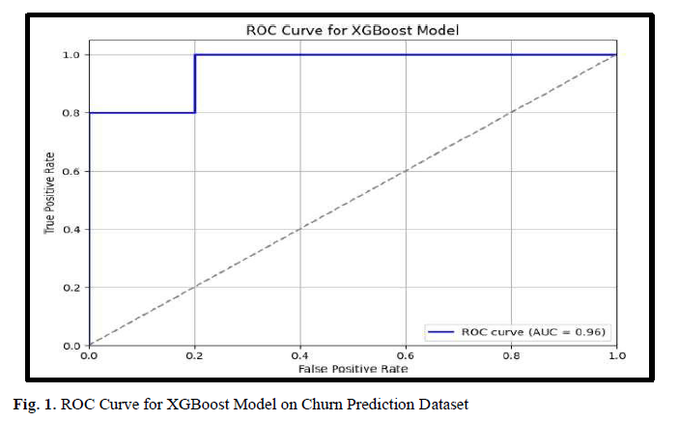
Results & Discussions
IISU-ASSET 2025
Model performance is measured by the AUC (Area under the ROC Curve), which goes from 0.5 for random guessing to 1.0 for perfect accuracy. An elevated AUC signifies superior model effectiveness in distinguishing between classes.
Model Performance:
Voting Classifier outperformed other models with the highest prediction accuracy.
Ensemble models (Random Forest, XGBoost) provided superior results.
Feature Importance Analysis:
  Transaction history, platform usage, and recency of purchase were key predictors of churn.
Model | Accuracy (%)
Stacking Classifier | 97.33
Bagging Classifier | 94.84
Voting Classifier | 96.81
Tuned Stacking Classifier | 97.51

Slide 7
Conclusion & Future work
IISU-ASSET 2025
Conclusion:
Churn Sage successfully predicts customer churn using ML & XAI.
High accuracy models like Stacking & Voting Classifiers outperform traditional methods.
Helps businesses take proactive steps for customer retention.
Future Enhancements:
To implement real-time churn prediction pipelines.
Explore deep learning models for better predictions in the future with 100% accuracy.
To Use customer segmentation & clustering for targeted retention strategies.

Slide 8
References
IISU-ASSET 2025
Shahabikargar, Maryam, et al. (2024) – Focuses on Generative AI for feature engineering, which aligns with how Churn Sage optimizes feature selection for better churn prediction.
Phumchusri, Naragain, and Phongsatorn Amornvetchayakul (2024) – Discusses ML models for churn prediction in SaaS, which is relevant as your project applies ML to customer churn analysis.
Aaron, Joshua, et al. (2024) – Explores churn prediction in grocery e-retailing, adding a real-world business application perspective.
Forghani Dehnavi, Seyed Mohammad, et al. (2022) – Covers Deep Learning-based churn prediction models and customer retention strategies, which connects with potential future enhancements for Churn Sage.

Slide 9

Thank You
IISU-ASSET 2025
IISU-ASSET 2025

